Slide 1
Welcome to
Data analysis and visualisation in R for Biologists We’ll start at 10:00, please ask if you have any issues with installation of R and RStudio
Irina & Rao
Michaelmas 2024

Slide 2
Data analysis and visualisation in R for Biologists Session 3 Data exploration in depth
Irina & Rao
Michaelmas 2024

Slide 3
R for biologists
Data Visualisation
Adding statistics to plots
Colours
Heatmaps
PCA
Plotly, PCA-explorer
Q & A

Slide 4
Basic statistics
Correlations – cor(), cor.test()
T-test (parametric):
Unpaired 2-group t-test
t.test(y~x) # where y is numeric and x is a binary factor
t.test(y1,y2) # where y1 and y2 are numeric
Paired 2-group t-test
t.test(y1,y2, paired=TRUE) # where y1 & y2 are numeric
Non-parametric tests:
Unpaired 2-group Mann-Whitney U Test
wilcox.test(y~A) # where y is numeric and A is A binary factor
wilcox.test(y,x) # where y and x are numeric
Paired 2-group Wilcoxon Signed Rank Test
wilcox.test(y1,y2, paired=TRUE) # where y1 and y2 are numeric
More than 2 groups - analysis of variance (ANOVA, parametric)
aov(), anova()

Slide 5
Adding statistics to the plots
library(ggpubr)
Perform the test
compare_means(formula, data, method = "wilcox.test", paired = FALSE, group.by = NULL, ref.group = NULL, ...)
*method = "t.test", "anova"
Or just add the significance levels to the plot
stat_compare_means(mapping = NULL, comparisons = NULL, hide.ns = FALSE, label = NULL, label.x = NULL, label.y = NULL, ...)
If adjusted p-values are required
stat_pvalue_manual(stat.test, label = "p.adj.signif”, hide.ns = TRUE, ...)

Slide 6
Adding statistics to the plots - alternatively
library(ggsignif)
stat_signif(mapping = NULL, data = NULL, position = "identity", na.rm = FALSE, show.legend = NA, inherit.aes = TRUE, comparisons = NULL, test = "wilcox.test", test.args = NULL, annotations = NULL, map_signif_level = FALSE ...)
map_signif_level = c("***"=0.001, "**"=0.01, "*"=0.05)

Slide 7

Let’s explore practically

Slide 8
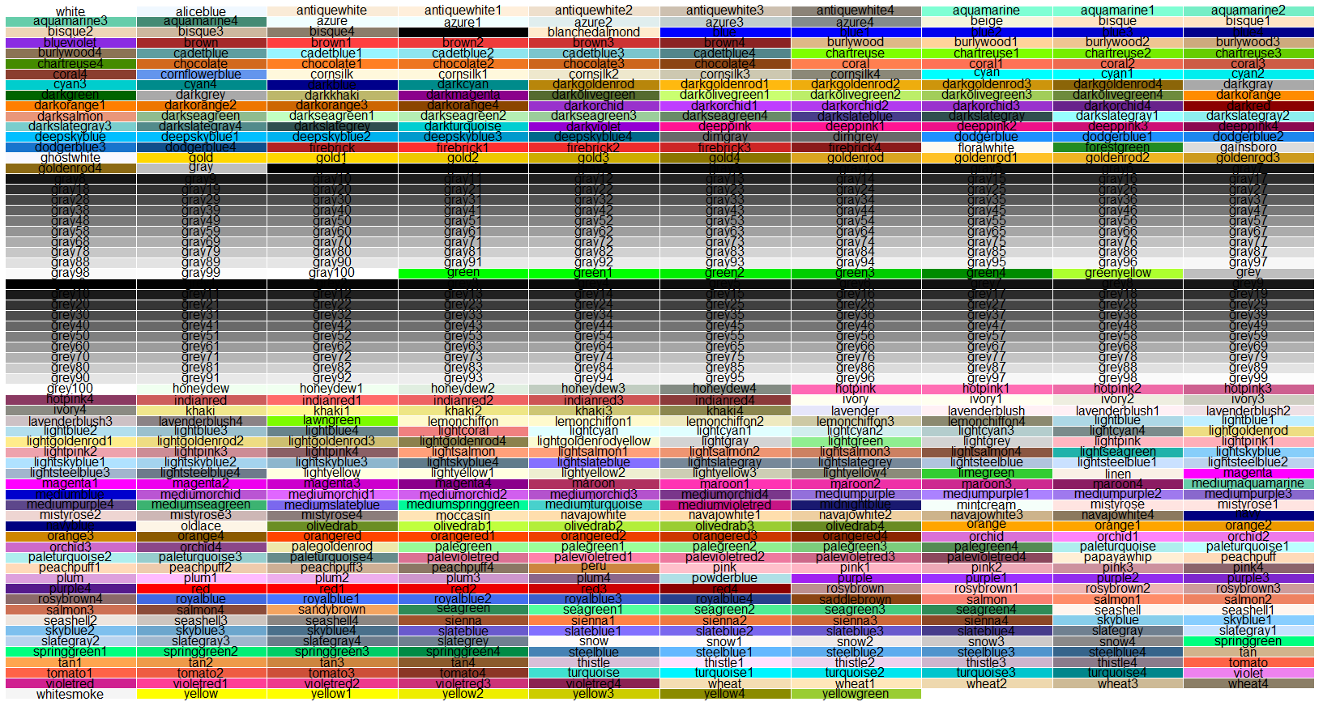
Colours in R
Represented as named colours (e.g. “red”, “mediumspringgreen”) or hexadecimal code (e.g. “#FF0000FF”, “#00FA9AFF”)

Slide 9
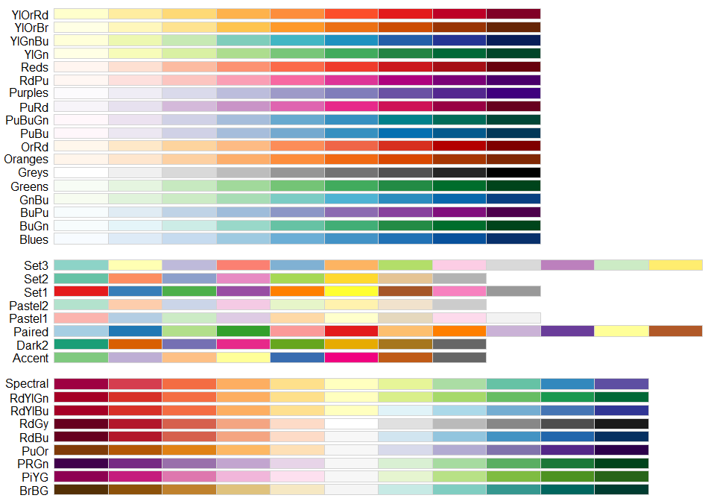
Colours in R
Palettes – a set of colours that can be used together
RColorBrewer package
Sequential
Qualitative
Diverging
https://github.com/EmilHvitfeldt/r-color-palettes for a huge list of palettes and the packages they come in

Slide 10
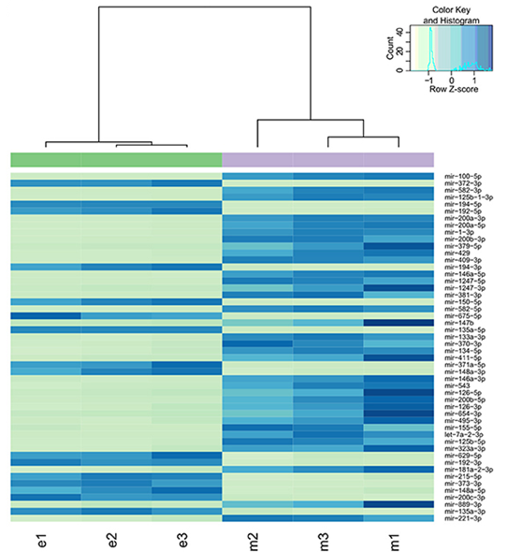
Heatmaps
Useful for displaying multidimensional data
A number of parameters
heatmap.2() function from the gplots package
Legend
Hierarchical clustering
Additional annotation
Colours
Row annotation
Column annotation

Slide 11
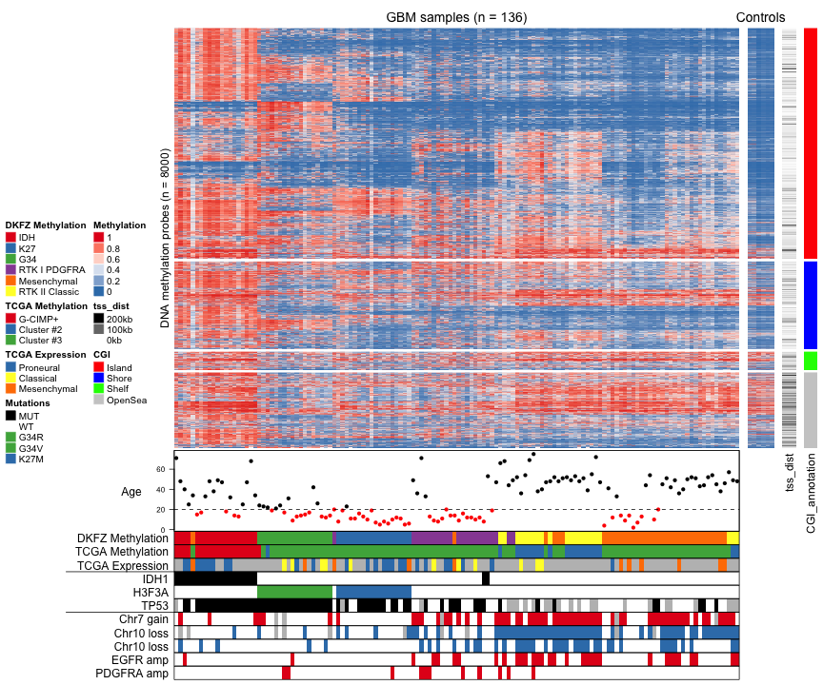
A lot of information can be conveyed!
A more complicated example with the Complex Heatmap package
https://github.com/jokergoo/ComplexHeatmap

Slide 12
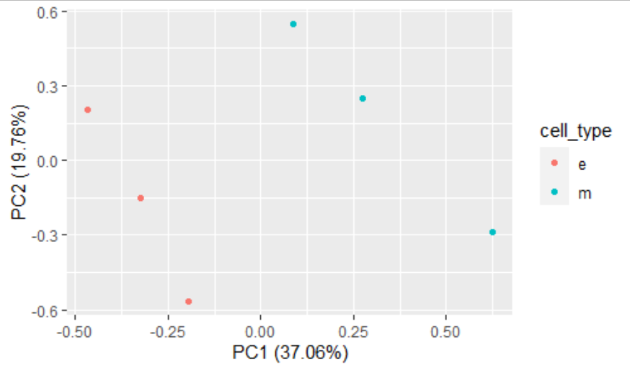
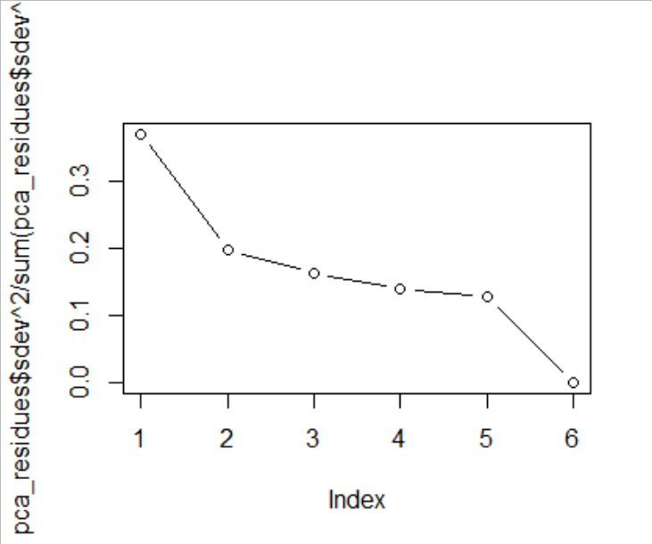
Principal Component Analysis
How many components should you consider?
https://builtin.com/data-science/step-step-explanation-principal-component-analysis

Slide 13
Let’s explore practically

Slide 14
Useful references
https://github.com/EmilHvitfeldt/r-color-palettes - a huge list of R palettes
https://colorbrewer2.org/ - RColorBrewer package based on this tool by Cynthia Brewer
https://jokergoo.github.io/ComplexHeatmap-reference/book/ - R package to produce Complex Heatmaps
https://carriebrown.github.io/r-novice-gapminder/challenges/ - R challenges
https://rosalind.info/problems/locations/ - biological programming and algorithmic challenges (mainly geared towards python, but can be solved using R as well)

